Slide 1
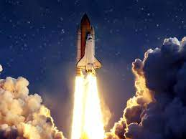

SPACEX LAUNCHING ANALYSIS PROJECT
By: M . A. Patrick

Slide 2


Table of Contents
1..Executive Summary
2.Introduction
3.Methodology
.Data Collection
.Data Wrangling
4.Results
.Data Analysis
.Data Visualization
5.Conclussions
Appendix

Slide 3

Introduction
PROJECT BACKGROUND AND CONTEXT
The project was carried out to predict if the Falcon 9 rocket launches on its website with a cost of $62 million ,other providers cost upward of $165 million each.Much of the savings is attributed to the fact that Spacex reuses the First stage.
Therefore if we can determine if the first stage will land ,we can determine the cost of a Launch.
This information can be used if an alternate company wants to bid against Spacex for a Rocket Launch.
Common Problems to be solved
1.What influences if the rocket will land successfully?
2.The effect of each relationship with certain rocket variables will impact in determining the success rate of a successful landing.
3.What conditions does Spacex have to achieve to get the best results and ensure the best rocket success landing rate.

Slide 4
Methodology
Data Collection Methodology
1.Spacex Rest API
2.Webscraping from Wikipedia
Performed Data Wrangling
Cleaning of Data &Encoding them to be in the right format for easy analysis
Performed Exploratory Data Analysis(EDA) visualization and SQL (Plotting scatter graphs and bar graphs to show relationship between variables & to show patterns in data)
Performed Interactive Visual Analytics using Folium & Plotly Dash
Performed Predictive Analysis using (classification )models
Building ,tuning and evaluating classification models

Slide 5



Data Collection
Source
Rest API
Webscraping
Data sets were collected by;
Spacex Rest API –api.spacexdata.com/v4/
Webscraping Wikipedia using Beautifulsoup
Collecting data with API call
Creating the beautifulsoup
Getting column names
Converting to dataframe with the help of JSON
Creating the launch_dict
Updating columns and rows(preprocessing)
Filtering the data to keep only Falcon 9 launches
Converting to final dataframe
Convert the data to CSV file
Convert data to CSV file

Slide 8
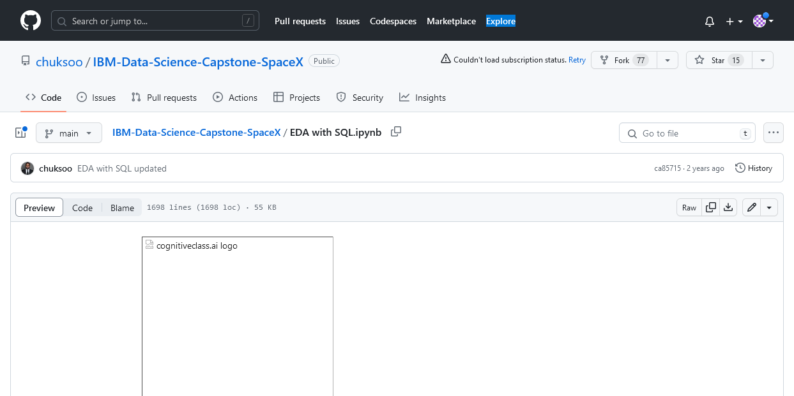

Slide 9
Chart

Slide 11
Table
 | Category 1 | Category 2 | Category 3 | Category 4
Item 1 | 4.5 | 2.3 | 1.7 | 5.0
Item 2 | 3.2 | 5.1 | 4.4 | 3.0
Item 3 | 2.1 | 1.7 | 2.5 | 2.8
Item 4 | 4.5 | 2.2 | 1.7 | 7.0

Slide 12

The way to get started is to quit talking and begin doing.
Walt Disney

Slide 13
Team
Name Title
Name Title
Name Title
Name Title

Slide 14
Timeline
Title
To start a presentation, go to the Slide Show tab, and select From Beginning.
Title
To display Presenter view, in Slide Show view, on the control bar at the bottom left select the three dots, and then Show Presenter View.
Title
During your presentation, the speaker notes are visible on your monitor, but aren't visible to the audience.
Title
The Notes pane is a box that appears below each slide. Tap it to add notes.
Title
If you don’t see the Notes pane or it is completely minimized, click Notes on the task bar across the bottom of the PowerPoint window.

Slide 15
Content
Subtitle
Subtitle
Add text, images, art, and videos.
Add transitions, animations, and motion.
Save to OneDrive, to get to your presentations from your computer, tablet, or phone.
Open the Design Ideas pane for instant slide makeovers.
When we have design ideas, we’ll show them to you right there.

Slide 16
Additional content
Subtitle
Subtitle
Subtitle
Add text, images, art, and videos.
Add transitions, animations, and motion.
Save to OneDrive, to get to your presentations from your computer, tablet, or phone.
This PowerPoint theme uses its own unique set of colors, fonts, and effects to create the overall look and feel of these slides.
PowerPoint has tons of themes to give your presentation just the right personality.
Open the Design Ideas pane for instant slide makeovers.
When we have design ideas, we’ll show them to you right there.

Slide 17




Summary
With PowerPoint, you can create presentations and share your work with others, wherever they are. Type the text you want here to get started. You can also add images, art, and videos on this template. Save to OneDrive and access your presentations from your computer, tablet, or phone.

Slide 18


Thank you
Presenter name
Email address
Website

